Slide 1

A Study of Person Entity Extraction and Profiling from Classical Chinese Historiography
Yihong Ma¹, Qingkai Zeng², Tianwen Jiang², Liang Cai³, Meng Jiang²
¹School of Finance, Shanghai University of Finance and Economic
²Department of Computer Science and Engineering, University of Notre Dame
³Department of History, University of Notre Dame

Slide 2
Motivation
Questions of interest by historians:
Who came from where?
Who studied from whom?
Who did what?
Challenges:
Heavy reliance on domain knowledge
historians have to spend even longer time learning the specific ancient language first.
Time-consuming

Slide 3
Person Entity Extraction
Sounds like a simplified NER task?
Yes but Not Exactly!
Different ways of mentioning one specific person:
$Hometown + $LastName + $FirstName + $CourtesyName
e.g. 蘭陵|孟|喜|長卿; newyork|trump|donald|john
$Hometown + $LastName + $FirstName
e.g. 蘭陵|孟|喜; newyork|trump|donald
$LastName + $FirstName + $CourtesyName
e.g. 孟|喜|長卿; trump|donald|john
$LastName + $FirstName
e.g. 孟|喜; trump|donald
$FirstName
e.g. 喜; donald

Slide 4
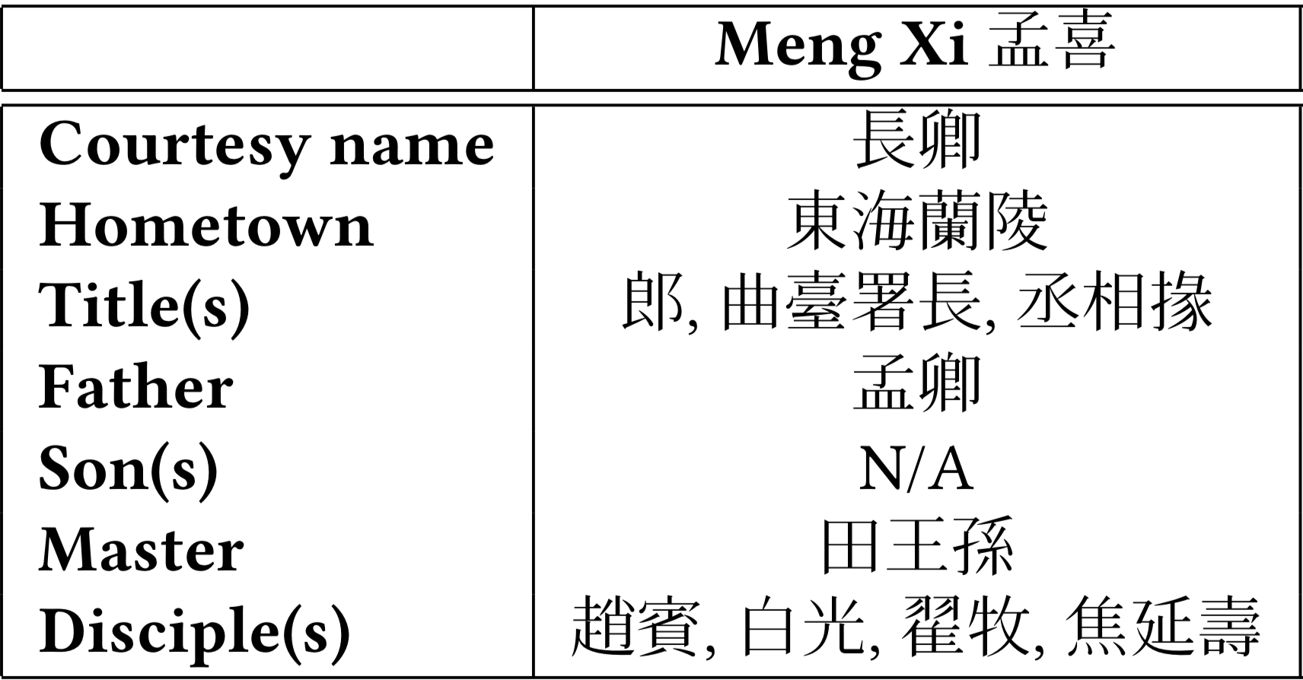
Person Entity Profiling
Definition:
Given the classical Chinese historiography, the task of person entity profiling aims to extract demographic attributes (e.g., courtesy name, place of birth, title) and social relations (e.g., father-son, master-disciple) and to generate a complete profile for the person entities extracted
Example:

Slide 5
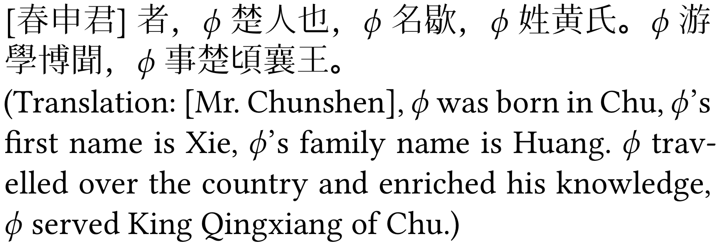
Person Entity Profiling (cont.)
The great variety of demographic attributes:
Each type of attributes needs a set of specific, reliable extractors, which requires prior knowledge of the classical Chinese language.
Zero Pronoun (ZP):
Not only occur in the same sentence with the mention of the person entity but also across several sentences in the same paragraph.

Slide 6
Key Observation/Assumption
Given a paragraph, as long as a person entity was extracted in the first clause, the ZPs in every clause of the paragraph refer to that person entity.
Intuition: In biographical historiography, each chapter is the life story of a certain historical figure.

Slide 7
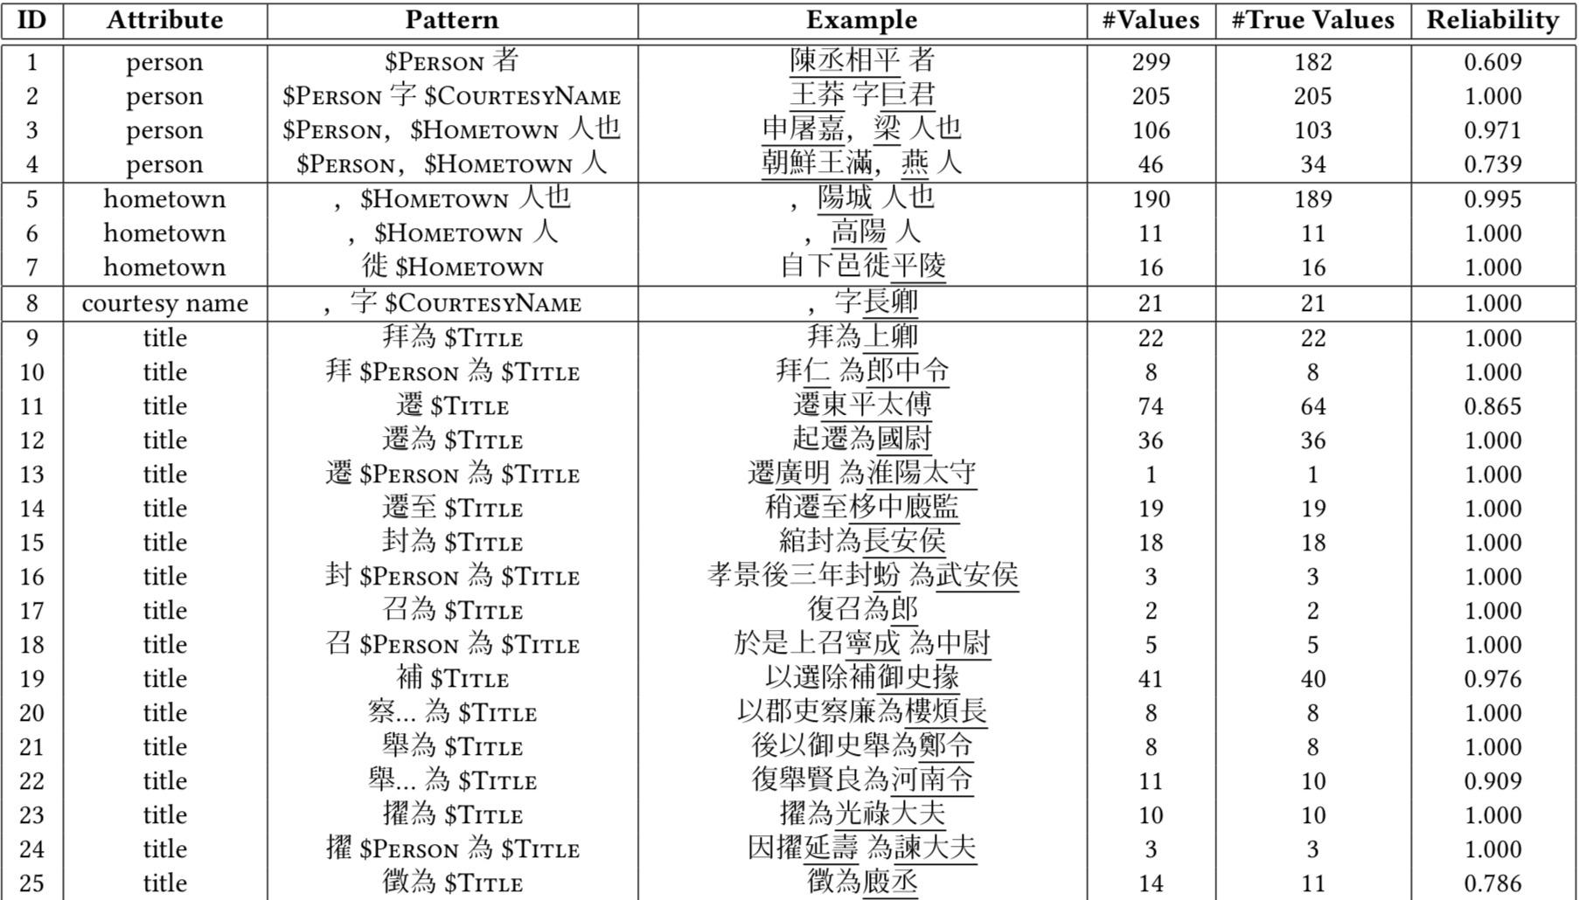
Handcrafted Patterns

Slide 8
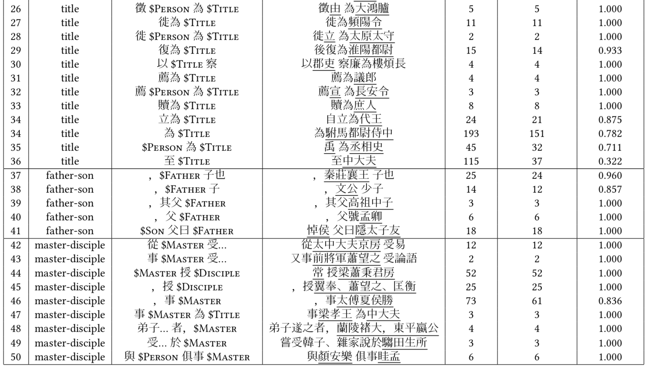
Handcrafted Patterns (cont.)

Slide 9
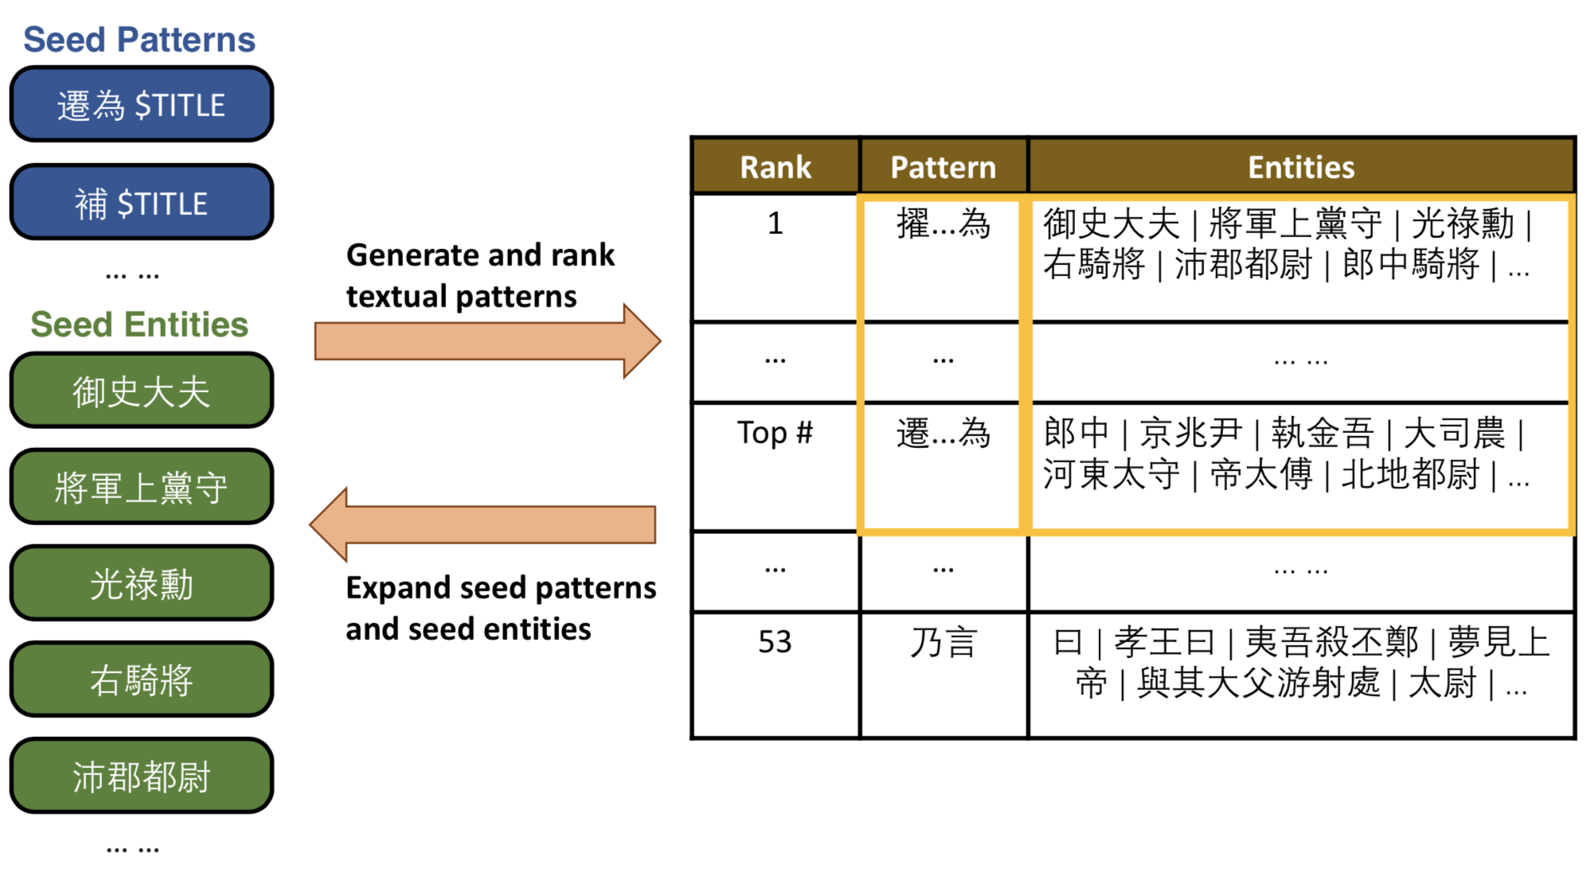
Pattern-based Bootstrapping
Step 1
Generate pattern candidates
Step 2
Rank pattern candidates
Step 3
Select new patterns and extract new values for the next iteration

Slide 10
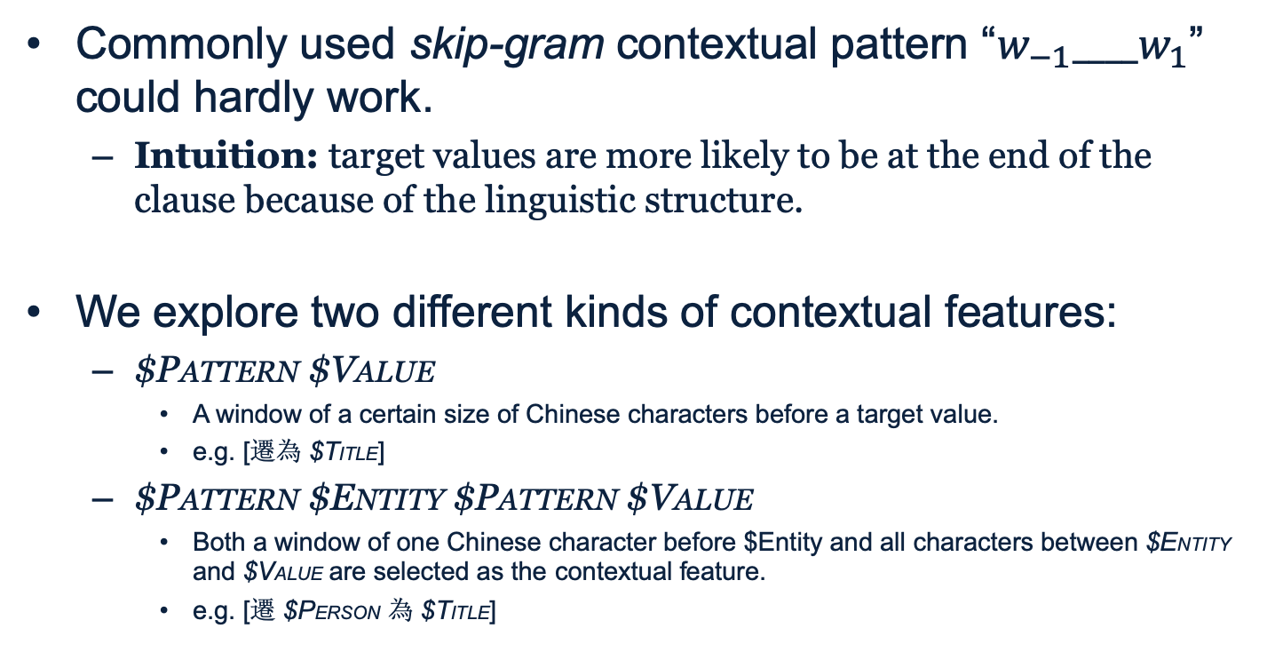
Generate Pattern Candidates
Commonly used skip-gram contextual pattern “$w_{−1}____w_{1}$” could hardly work.
Intuition: target values are more likely to be at the end of the clause because of the linguistic structure.
We explore two different kinds of contextual features:
$PATTERN $VALUE
A window of a certain size of Chinese characters before a target value.
e.g. [遷為 $TITLE]
$PATTERN $ENTITY $PATTERN $VALUE
Both a window of one Chinese character before $Entity and all characters between $ENTITY and $VALUE are selected as the contextual feature.
e.g. [遷 $PERSON 為 $TITLE]

Slide 11
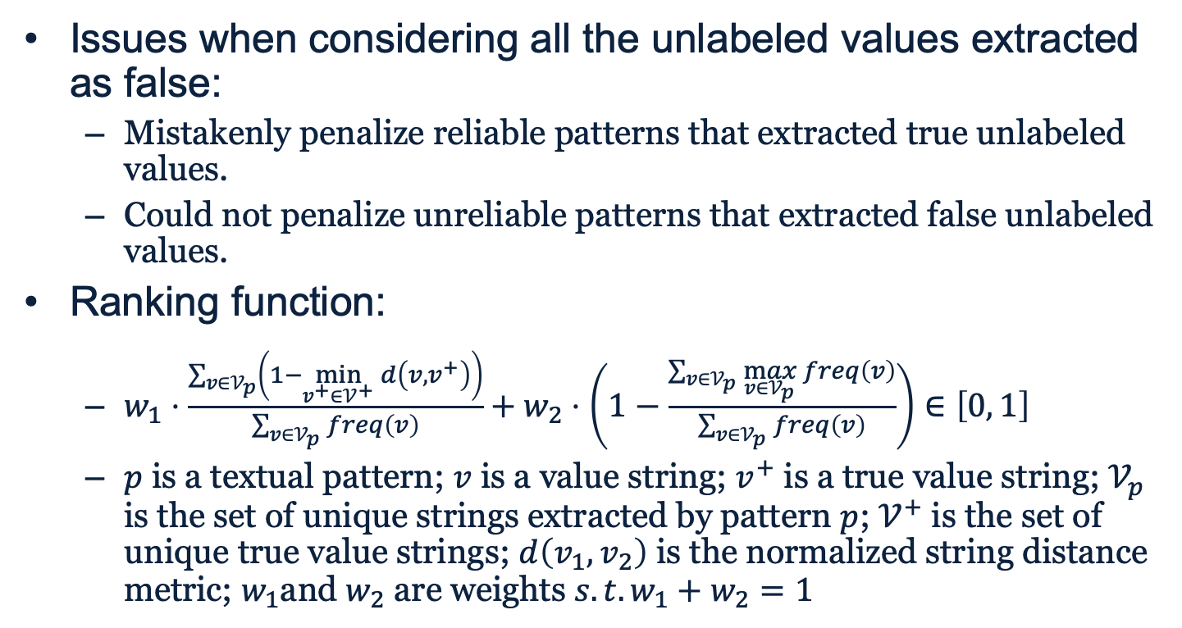
Rank Pattern Candidates
Issues when considering all the unlabeled values extracted as false:
Mistakenly penalize reliable patterns that extracted true unlabeled values.
Could not penalize unreliable patterns that extracted false unlabeled values.
Ranking function:
$w_{1}⋅\frac{\sum_{v∈𝒱_{p}}{\left(1−\min_{v^{+}∈𝒱^{+}}{d\left(v, v^{+}\right)}\right)}}{\sum_{v∈𝒱_{p}}{freq\left(v\right)}}+w_{2}⋅\left(1−\frac{\sum_{v∈𝒱_{p}}{\max_{v∈𝒱_{p}}{freq\left(v\right)}}}{\sum_{v∈𝒱_{p}}{freq\left(v\right)}}\right)∈\left[0, 1\right]$
$p$ is a textual pattern; $v$ is a value string; $v^{+}$ is a true value string; $𝒱_{p}$ is the set of unique strings extracted by pattern $p$; $𝒱^{+}$ is the set of unique true value strings; $d\left(v_{1},v_{2}\right)$ is the normalized string distance metric; $w_{1}$and $w_{2}$ are weights $s.t. w_{1}+w_{2}=1$

Slide 12
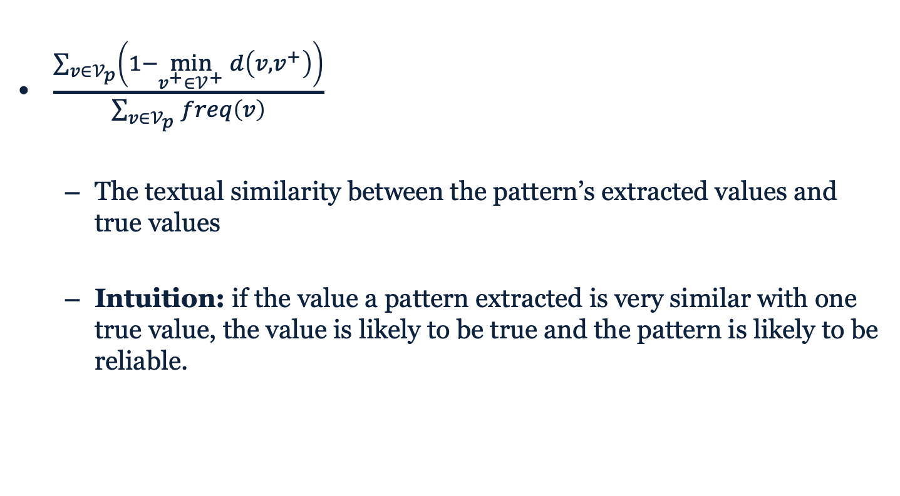
Rank Pattern Candidates (cont.)
$\frac{\sum_{v∈𝒱_{p}}{\left(1−\min_{v^{+}∈𝒱^{+}}{d\left(v, v^{+}\right)}\right)}}{\sum_{v∈𝒱_{p}}{freq\left(v\right)}}$
The textual similarity between the pattern’s extracted values and true values
Intuition: if the value a pattern extracted is very similar with one true value, the value is likely to be true and the pattern is likely to be reliable.

Slide 13
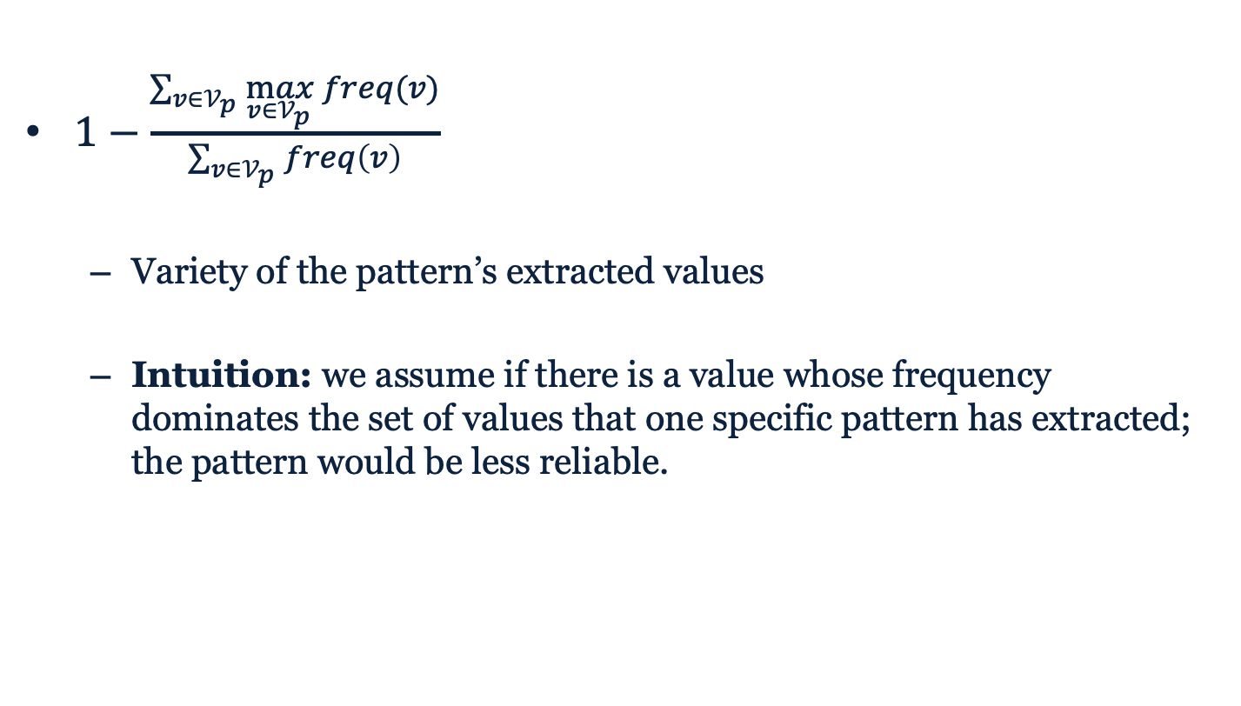
Rank Pattern Candidates (cont.)
$1−\frac{\sum_{v∈𝒱_{p}}{\max_{v∈𝒱_{p}}{freq(v)}}}{\sum_{v∈𝒱_{p}}{freq\left(v\right)}}$
Variety of the pattern’s extracted values
Intuition: we assume if there is a value whose frequency dominates the set of values that one specific pattern has extracted; the pattern would be less reliable.

Slide 14
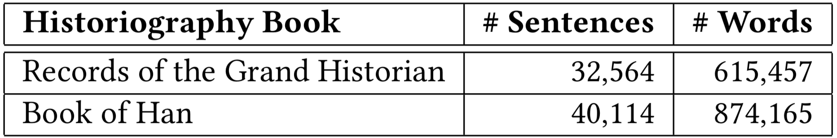
Experiment Settings
Dataset statistics:

Slide 15
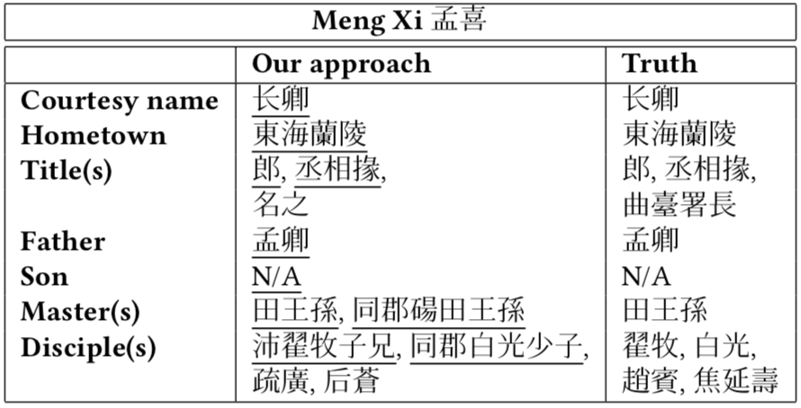
Evaluating the Handcrafted Patterns
Evaluation method:
Ground-truth: 15 complete person profiles (with 158 values) annotated by domain experts.
Metrics: Precision, Recall, and F1 score.
Evaluation result:
Precision: 0.901; Recall: 0.803; F1: 0.851.

Slide 16
Evaluating the Effectiveness of the Bootstrapping Method
Evaluating the task of pattern extraction.
Evaluation the task of person-entity pair extraction.

Slide 17
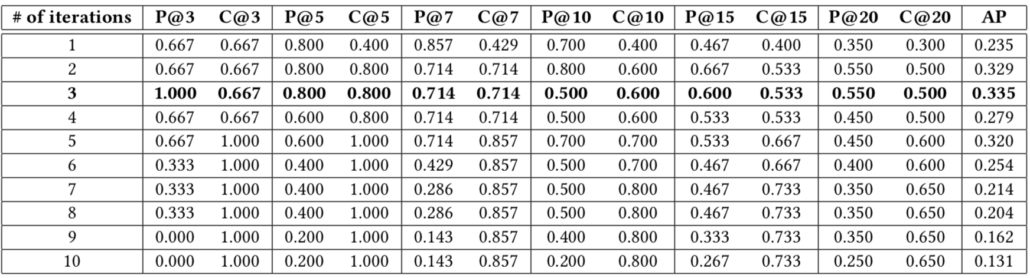
Evaluating the Task of Pattern Extraction
Evaluation method:
Ground-truth: handcrafted patterns for the attribute $TITLE
Metric:
Precision@K: the fraction of top K scored generated patterns that are in the ground-truth pattern set.
Coverage@K: the fraction of top K scored ground-truth patterns that are extracted by the bootstrapping method.
Average precision (AP): the mean of the precision scores after each relevant pattern is retrieved.
Evaluation result:

Slide 18
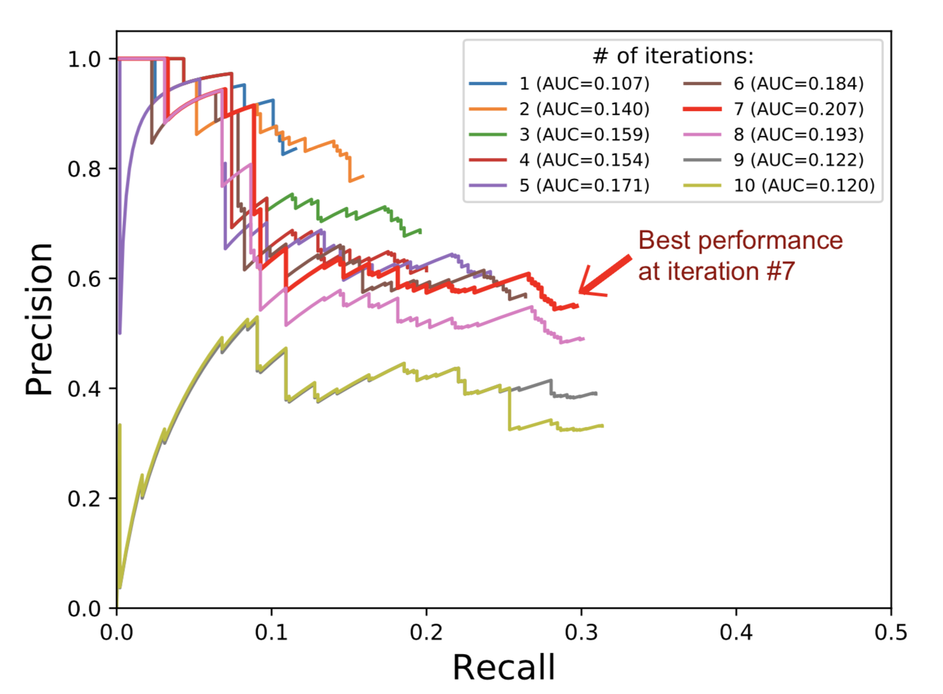
Evaluation the Task of Person-Entity Pair Extraction
Evaluation method:
Ground-truth: person-title pairs extracted by handcrafted patterns.
Metric: precision-recall curve.
Evaluation result:

Slide 19
Discussions
Bootstrapping only works for $TITLE
Preliminary: there should exist some entities that could be extracted by multiple patterns, which makes it possible to find new patterns through pattern generation.
The values of $TITLE could be shared by multiple patterns’ extractions because multiple people can be assigned to the same position in the government.
However, one person cannot have multiple fathers and rarely have multiple masters.
Besides, for relation extraction, each relation pair is unique in the text.

Slide 20
Conclusions
New dataset: We recruit history professors to curate a set of person profiles from classical Chinese literature.
New approach: We develop a bootstrapping method based on textual patterns to extract the person entities and attributed information, requiring little prior knowledge.
Effectiveness: Experiments show that textual patterns make an F1 score of 0.851 on 15 person profiles annotated by the domain experts.

Slide 21

Thank You!
Any questions?

